Slide 1
Sarah Learns the Ruby Standard Library
Part 1: FileUtils & CSV

Slide 2


Slide 3
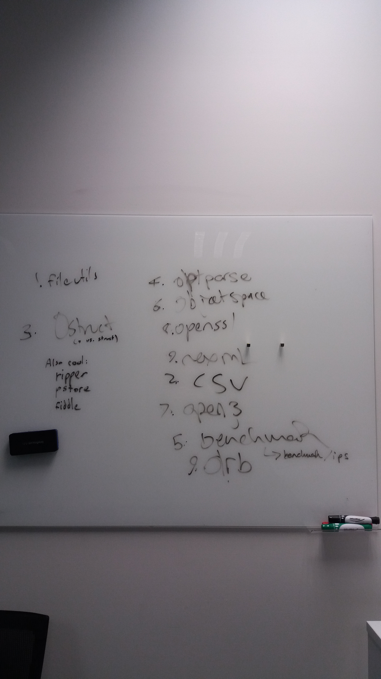

Slide 5
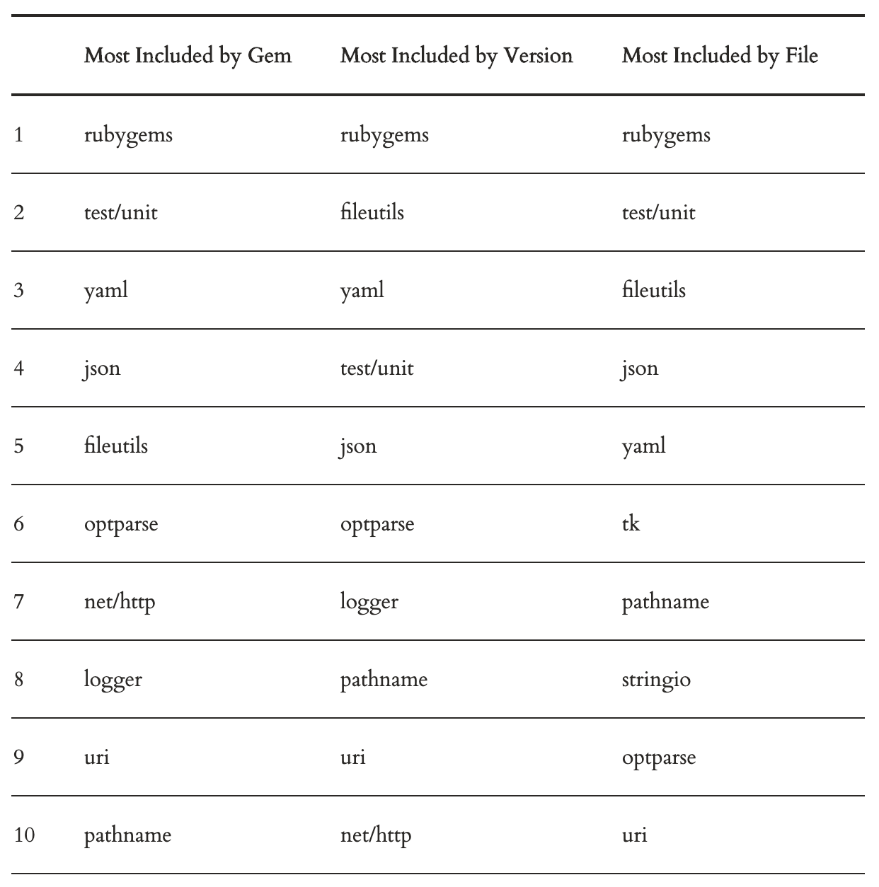

Slide 6
FileUtils

Slide 7


Slide 8
FileUtils
Mimics UNIX commands / flags
Modules
Options
Methods

Slide 9
Recursive Forced Deletion
In Unix Shell with flags:
$ rm –rf ‘folder’
In FileUtils with underscores:
> FileUtils.rm_rf ‘folder’

Slide 10
Create nested folder structure
In Unix Shell with flags:
$ mkdir –p ‘folder/nested_folder’
In FileUtils with underscores:
> FileUtils.mkdir_p ‘folder/nested_folder’

Slide 11
Modules

Slide 12
Modules
::Verbose
::NoWrite
::DryRun

Slide 13
Options
:verbose
:noop
:preserve
:force

Slide 14
Methods

Slide 15
Permissions (Symbolic Notation)
Actor
u user
g group
o other
a all

Slide 16
Permissions (Symbolic Notation)
Operation
+ add
- subtract
= assign absolute

Slide 17
Permissions (Symbolic Notation)
Permission Type
r read
w write
x execute
X special execute
s setgid

Slide 18

Permissions (Symbolic Notation)
u+x,go+rx

Slide 19
Permissions (Octal Notation)
0 - no access to the file
1 - execute only
2 - write only
3 - write and execute
4 - read only
5 - read and execute
6 - read and write
7 - read, write and execute (full permissions)

Slide 20
Permissions (Octal Notation)
0755

Slide 21
Methods
#cp
#mv
#rm
#touch
#mkdir
#chmod

Slide 22
LOW_Methods

Slide 23
LOW_Methods
#cd
#copy_file
#copy_stream
#compare_file
#compare_stream

Slide 24
FileUtils: What have we covered?
modules
options
methods
UNIX flags
permissions
scoping
streaming

Slide 26
CSV

Slide 27
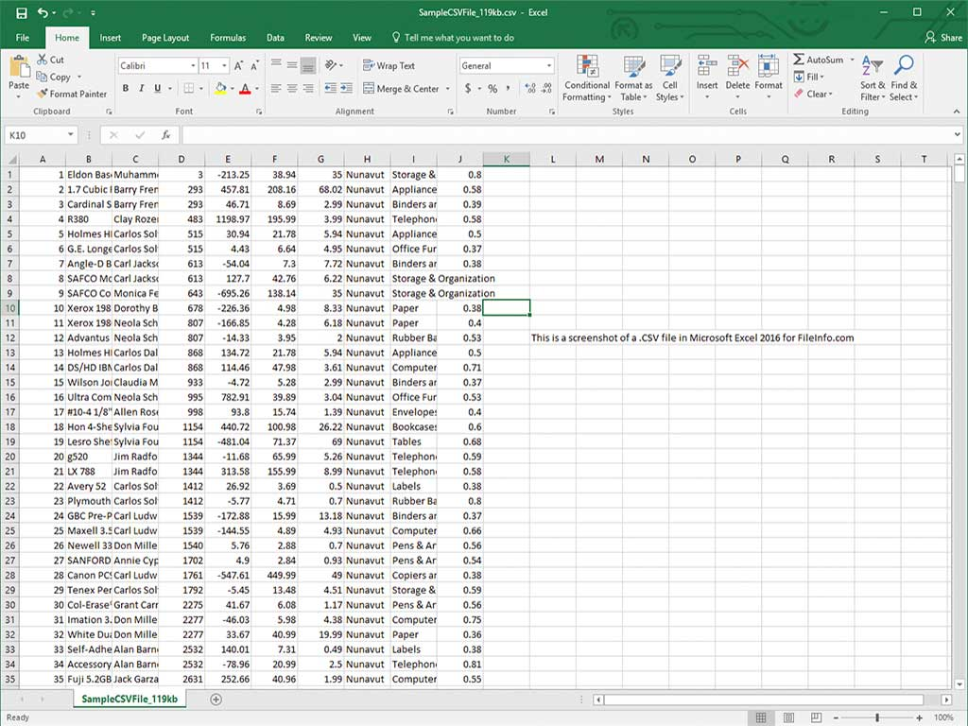

Slide 28
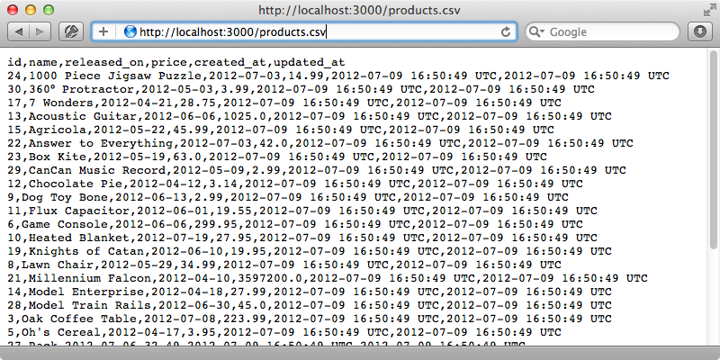

Slide 29
CSV
Converting
Reading
Writing
Modifying
Streaming

Slide 30
Converting

Slide 31
Converting
#generate_line
Single Row
Array#to_csv
Input: Array of values
Output: String of csv

Slide 32
Converting
#parse_line
Single Row
String#parse_csv
Input: String of csv
Output: Array of values

Slide 33
Creating/
editing

Slide 34
Creating/editing
Modes
r Read-only, starts at beginning of file (default)
r+ Read-write, starts at beginning of file.
w Write-only, overwrites existing/creates a new file.
w+ Read-write, overwrites existing/creates a new file
a Write-only, appends existing/creates a new file
a+ Read-write, appends existing/creates a new file

Slide 35
Creating/editing
#open
write_headers: true
headers: [‘Album’, ‘Title’]
col_sep: ‘|’
row_sep: nil

Slide 36
Creating/editing
#filter
input_file
output_file
headers: true
header_converters: :symbol

Slide 37
Creating/editing
#read
headers: true
header_converters: :symbol
skip_blanks: true

Slide 38


Slide 39
processing

Slide 40
processing
(Dalibor Nasevic)

Slide 42
processing
#read
#parse
#new
Wrapping an IO object
File.open(‘file’) { |file| CSV.new(file) }
#foreach

Slide 43
Streaming
With Rack/Rails

Slide 44
Streaming
(Bernardo Farah)

Slide 45
streaming
File Headers
Streaming Headers
response.body
Enumerable responding to .each()
ActiveModel#for_each
Enumerable to fetch data in batches

Slide 46
CSV: What have we covered?
Converting
Reading
Writing
Processing
Streaming

Slide 47
Sources
Ruby Docs:
https://ruby-doc.org/stdlib-2.6.3/libdoc/csv/rdoc/CSV.html
https://ruby-doc.org/stdlib-2.6.3/libdoc/fileutils/rdoc/FileUtils.html
Tim Robertson 2014-07-23: Omniref Blogpost:
http://500errors.com/omniref/2014-07-24-whats-the-most-used-ruby-library.html
Dalibor Nasevic 2016-03-29: Processing CSV Blogpost:
https://dalibornasevic.com/posts/68-processing-large-csv-files-with-ruby
Bernardo Farah 2017-06-28: Streaming CSV Blogpost and Source Code:
https://github.com/berfarah/rails-streaming-example
https://www.bernardo.me/blog/2017/06/28/streaming-csv-with-rails/

